Slide 1
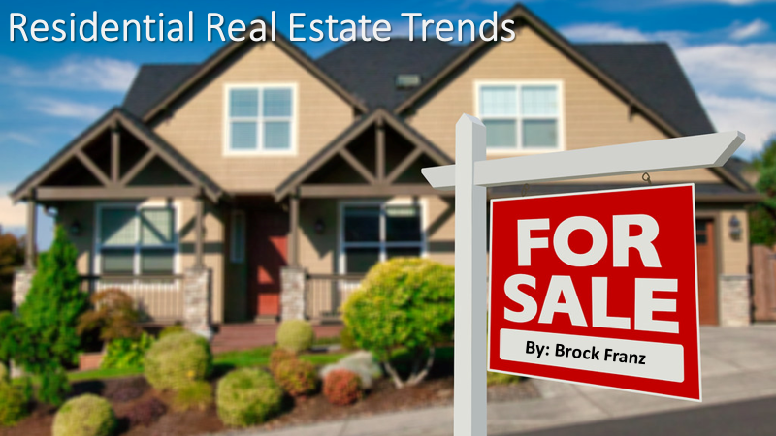
Notes:
Good evening, my name is Brock Franz and I am a data analyst from Gilbert, Az. I have been hired to research and recommend some financial advice for mortgage backed securities.
A little bit about me, I have been analyzing data in different ways for 15 years now. I recently graduated from Thinkful university where I did a deep dive study into Excel, SQL, Tableau, and Python to better my skills in interpreting and presenting data based information.

Slide 2
Objective
Identify current housing market trends through statistical analysis.
Hypothesize outcomes and run tests on data to prove truths in the numbers.
Make recommendations for investing into mortgage-backed securities.
Notes:
The objective today is for me to help identify current trends in the residential real estate market through statistical analysis. I will present my hypothesises and the outcome of each based on the data I was provided.

Slide 3
Basic analysis
The dataset contained information on 1451 home sales from Ames, Iowa between 2006 and 2010.
After cleaning the data home sales over $500,000 were removed as outliers for skewing the data disproportionately.
A two sample T-test was performed to eliminate bias and the two sample groups showed no significant difference at the 0.966 level.
Notes:
Let’s start at the beginning of the dataset. The data I was provided contains stats and figures from over 1400 homes sold in Ames, Iowa between 2006 and 2010.
After mapping the data in a scatterplot chart, outliers were identified that were anomalies in pricing and all sales over $500,000 were removed to ensure more accurate testing.
I split the data into 2 datasets at random to and performed a T-test on them to ensure a lack of bias. The test revealed no significant difference at the 0.966 level so testing continued.

Slide 4
garages
Ho: μ1 - μ2 = 0
Ha: μ1 - μ2 ≠ 0
The hypothesis was to compare the number of garages to the sales price to prove there is no significant difference in price regardless of the garage count.
Two separate T-tests were run comparing different garage counts.
The null was rejected with 95% confidence level and a P-value of p<.001.
There is a significant difference in the sales price compared to the garage counts. Three car garages demand a much higher sales price than any other type.
Notes:
After going through the variables, the first hypothesis I created was this, to prove or disprove that the size of the garage significantly affected the sales price of the homes.
I ran 2 sets of 2 sample T-tests, 1 car vs 2 car, and 2 car vs 3 car.
Both tests returned the same conclusion, to reject the null hypothesis as there is a significant difference in house pricing when comparing different sized garages.

Slide 5

Year built
A correlation test was run to prove or disprove that the age of the home correlates with the sales price.
With a correlation of 0.5251, there is a weak but moderate correlation between the two.
 | Year built | Average SalePrice
Yearbuilt | 1
Average SalePrice | 0.525198818 | 1
Notes:
Next I ran a correlation module on the year the homes were built compared to their sales price. The testing showed a moderate relationship between the 2 at 0.525 correlation.
While these 2 variables do in fact affect each other, it is not a very strong bond

Slide 6
Total square feet
Analysis was done to show whether there is significant correlation between the total square footage of the home versus the sale price.
At 0.8159, the correlation is very strong and clearly demonstrates the higher prices expected as the home gets larger.
 | Total Square Feet | Average Salesprice
Total Sqft | 1
Average Salesprice | 0.815909935 | 1
Notes:
Here I ran another correlation test but this time on total square footage of the property vs the sales price. As you can see from the chart there is a very strong relationship between these 2 variables.
At 0.81 correlation, the bigger the house, the bigger the bucks.

Slide 7

Neighborhood
The three highest price neighborhoods represent almost 10% of all home sales in the dataset.
Combined average sales price of $297,190 vs the total average of $181,145.
Notes:
Looking at the different neighborhoods in Ames, I separated them and graphed the average sales price per neighborhood,
While a very basic way to look at data, it still shows conclusively where the higher dollars are being spent.
Northridge, Northridge Heights, and Stonebridge represent almost 10% of the total sales and bring in over $116,000 more on average per sale than all other neighborhoods combined.

Slide 8

Lot size
A correlation analysis shows no significant relationship between lot size and sales price at 0.2404.
 | Lot Size | Sales Price
Lot Size | 1
Sales Price | 0.240432591 | 1
Notes:
Next, I ran another correlation module but this time on the lot size of the property vs the sales price. The data returned a very poor correlation at .2404 showing no significance relating the price to the lot size.

Slide 9

Years since remodel
After correlation model was complete the analysis showed no relationship between these variables.
 | Years since remodel | Average Sales Price
Years since remodel | 1
Average Sales Price | 0.034645238 | 1
Notes:
My love for correlation modules comes to a close with the comparison of the sales price and how many years since the property has been remodeled.
The weakest correlation yet at a measly 0.034.
These 2 clearly have nothing to do with each other.

Slide 10
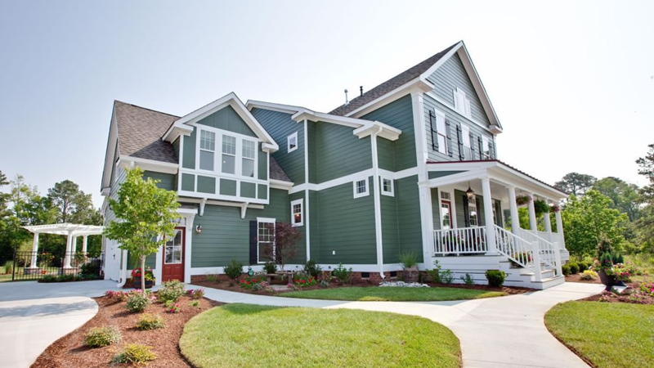
summary
Lot size and remodel year had no effect on sales prices.
Year built showed a moderate relationship to pricing.
Three neighborhoods proved to demand much higher prices than the rest.
Total square footage and larger garages highly impact the sales price of a home.
Notes:
In summary, we saw a lot of factors and variables and saw some clear cut statistical evidence of what works, and what doesn’t.
Lot sizes and remodeling years have little to no affect on the sales price of the homes.
While the correlation between the age of the home and price showed a moderate relationship, it wasn’t the home run we were looking for.
Location showed be a clear indicator of where the money is being spent in Ames.
The square footage and number of garages are clearly the front runners in indicators for bringing in top dollar in this residential real estate market.

Slide 11

When investing in mortgage-backed securities in and around Ames, Iowa, I recommend purchasing larger homes with three or more garages in Northridge, Northridge Heights, or Stonebridge.
These variables combined have proven to bring top dollar in this market and would be a safe investment any day based on the data.
Notes:
My recommendation for investing in Ames properties would be to seek out larger homes with 3 or more garages in Northridge, Northridge Heights, or Stonebridge.
These 3 variables all play a clear statistical part in bringing top dollar for a home and would clearly be a safe investment in today’s market.

Slide 12

Questions?
Thank you,
Brock Franz
Notes:
I want to thank you for your time and attention. Are there any questions?

